Slide 1

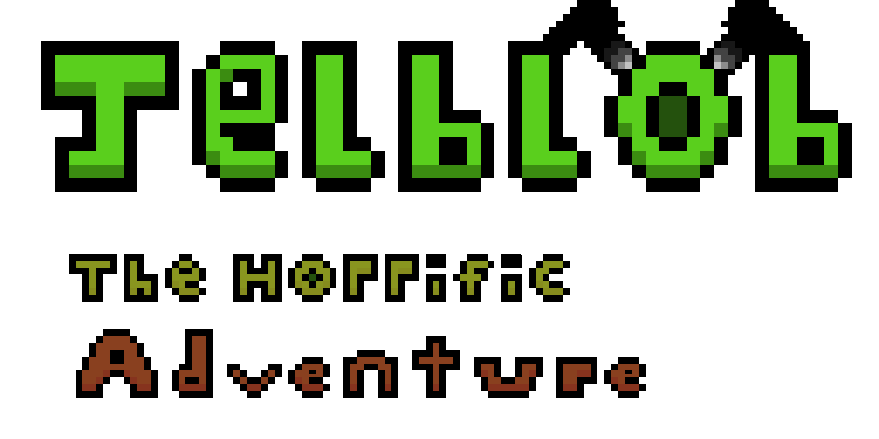




Slide 2
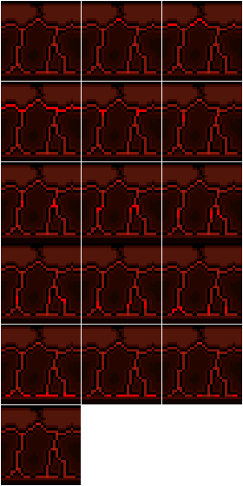
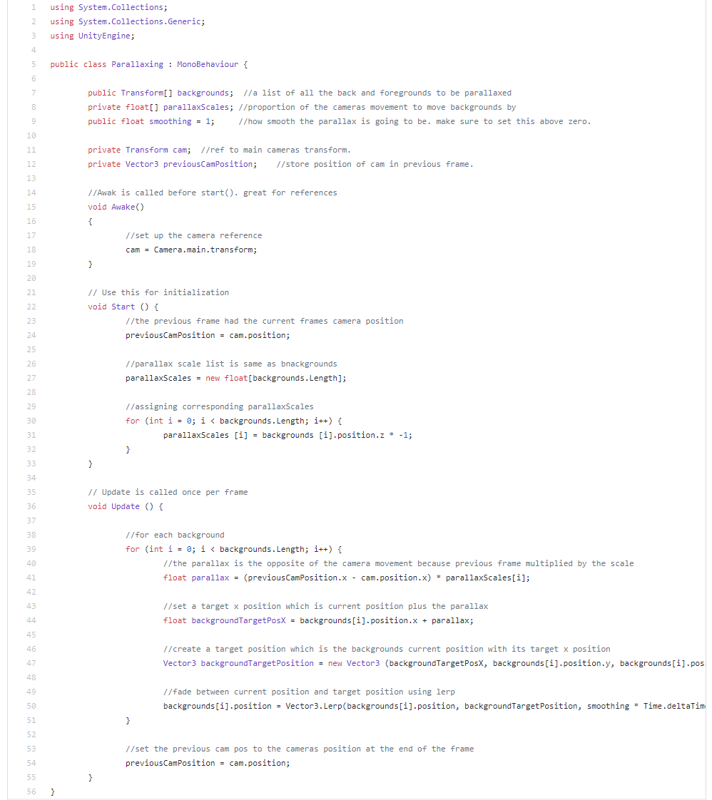
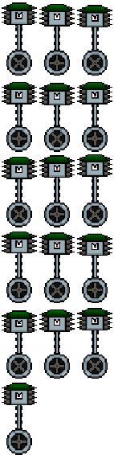
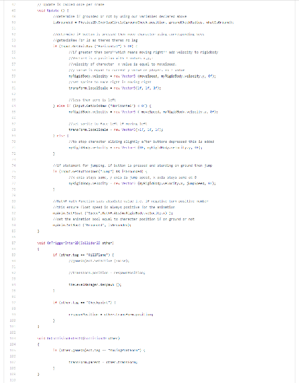
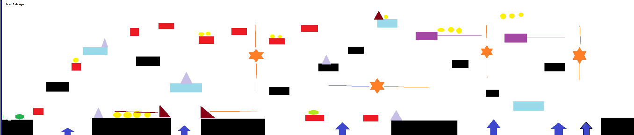
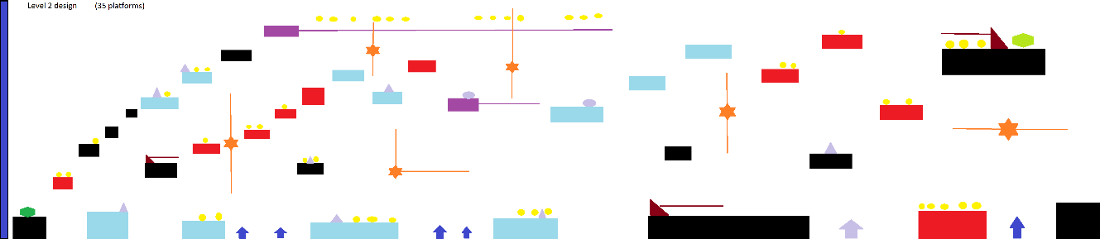
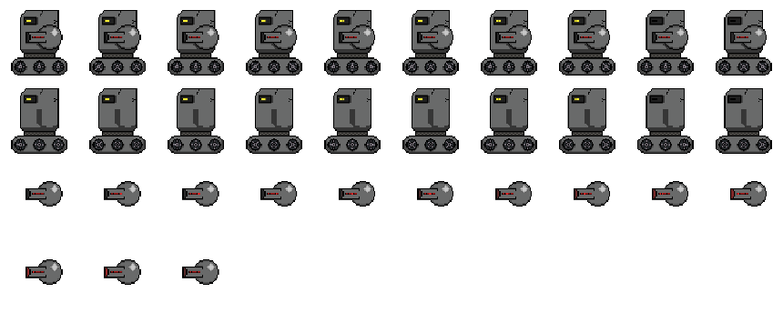
Introduction: The Project Team
Kenny Melville
[B00323186]
Alistair Walker
[b00305911]
Steven O’neill
[B00339826]
Kenny Melville
[B00323186]
Alistair Walker
[b00305911]
Steven O’neill
[B00339826]
Lead Programmer
Lead Games Designer & Audio Designer
Lead Artist
Notes:
[Name, Banner ID, Role]
[Mention the title of the game we are working on]

Slide 3
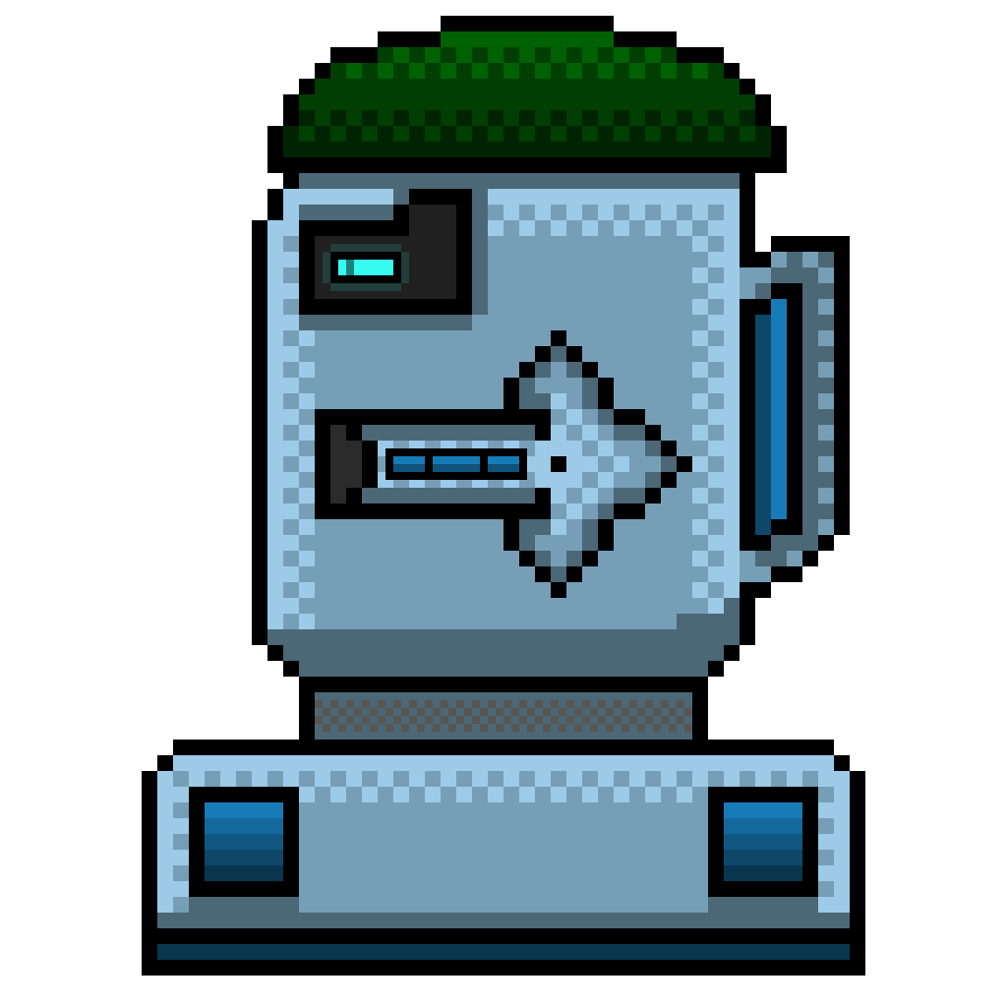
Features, Genre, Target Audience
Genre – 2D Side-scroller platformer
Player – Player 1 Experience ONLY (Single player)
Target Audience – 2D Platformer fans, Scroller fans, Quick play Gamers
Influences – Super Mario Bros (1985), Dark Souls (2009), Sonic the hedgehog (1991) and Super meat Boy (2010)
Uniqueness – Player Mass System
Notes:
[Talk about the genre the game is]
[Uniqueness of the game – what sets it apart from other games]
[Mention it is a Single Player game]
[Talk about the Target Audience and where the Influence for the game came from]
[Influences behind the game]

Slide 4
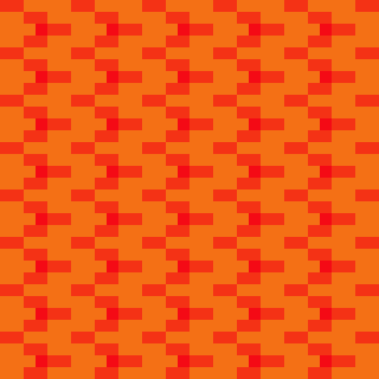
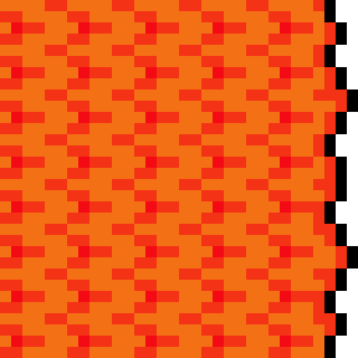




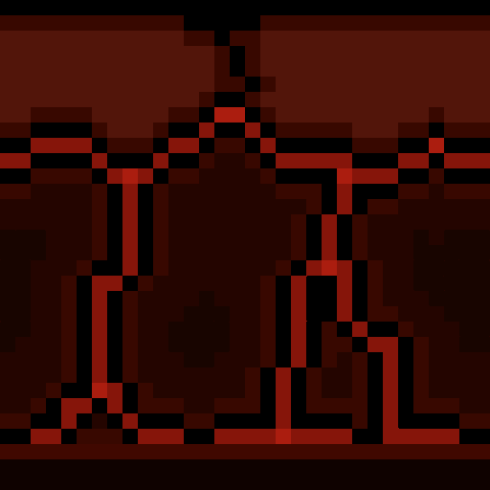
Story
“The Horrific Adventure tells the story of the time Jelblob was accidently abducted and taken aboard the evil(?) exotic animal dealer Dr. Magmim’s Bio ship. Upon realizing he had picked up the slime the Dr. begins his ruthless purge system that will lead to the death of Jelblob even at the cost of many of the doctor’s robotic minions and his exotic collection of animals. What follows in an epically difficult race for survival as Jelblob flees the purge system through many different Bio Domes in order to reach the ships core and escape back home.”
Dr Magmim
An (infamous evil?) genius who made his fortune by capturing and selling exotic creatures from planets across the universe.
Jelblob
A slime-jelly like monster which spends its days jumping around and fleeing from predators.
MAIN CHARACTERS GOAL
Escape from Dr Magmims Bio ship, and return home; or die trying!
Notes:
[Brief summary of the plot of the game]
[Mention the main character and the main antagonist]
[Main characters goal in the story]

Slide 5
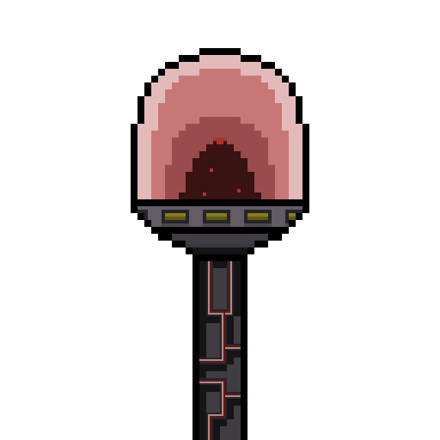
Setting and Environment
The setting of the world of ‘Jelblob’ that the player experiences, takes place within the Bio-Domes that are located within Dr Magmims space ship.
Each Bio-Dome has its own environment that the player traverses through, from a volcanic landscape with lakes of lava, to a valley of waterfall gorges.
However, each environment has its own type of chasing death hazard that is themed off the environment its found in.
Level 1
Volcanic
Hazard
Lava Tsunami
Level 2
Frozen
Hazard
Blizzard
Level 3
Jungle
Hazard
Fog of Death
Level 4
Desert
Hazard
Sandstorm
Level 5
Islands
Hazard
Tornado
Level 6
Subterranean
Hazard
Collapsing Ceiling
Level 7
Final
Hazard
LASER BEAM
Notes:
[Where the game takes place]
[The environments and world the player will be going through]

Slide 6
Gameplay and Mechanics
The core objective of the horrific adventure is survival and escape.
Simple classic platformer controls
One hit death, no forgiveness for mistakes
Unique mass system for the player linked with shooting and movement
The purge system (wall of death)
4 simple enemy types
2 pickup types
Notes:
[Talk about the core objectives of the game]
[Mention the player (controls and mechanics, enemies (behaviour and types), pickups and hazards]
// Slide Done by Kenny

Slide 7

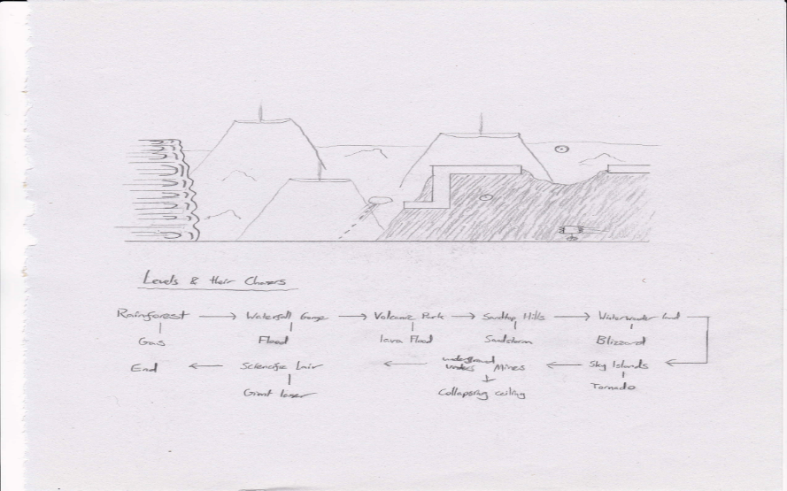
Level Design
Volcanic level design
Original Concept art
Notes:
[Show image of level concept for Volcanic level]
[Discuss level design approach]
[Discuss immersive aspects of the level related to the principles of level design – refer to lecture slides]
// Slide done by Kenny

Slide 8


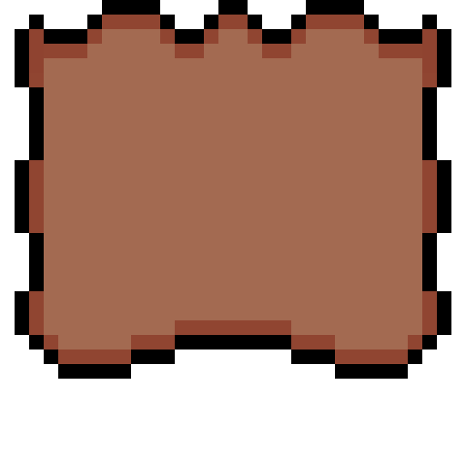
Audio Production for the game
All the non music audio was created by K.Melville using Audacity.
9 audio files created for the Game.
Player_jump Sound
Player_death Sound
Music will all be sourced from chiptunes giving the game a nostalgic 8-bit sound.
Audacity was an easy to use free software package.
Notes:
[Discuss audio – how it was created (e.g. via Audacity) – multiple sounds per level?
[Samples of the sounds]
[Discuss ease of use of the software? – how easy to integrate with Unity?]

Slide 9
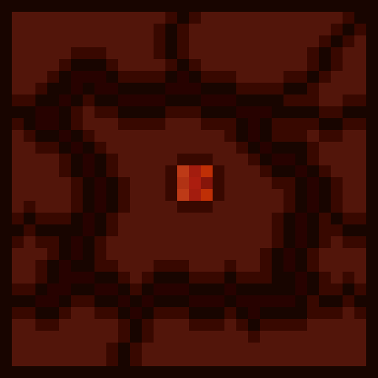
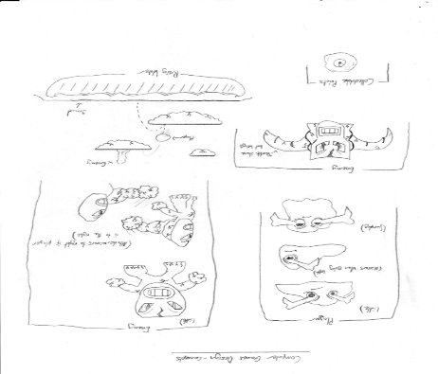
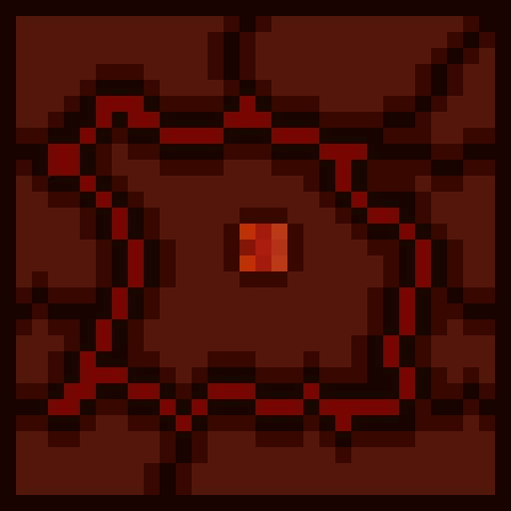
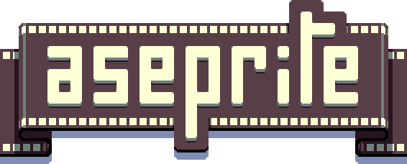

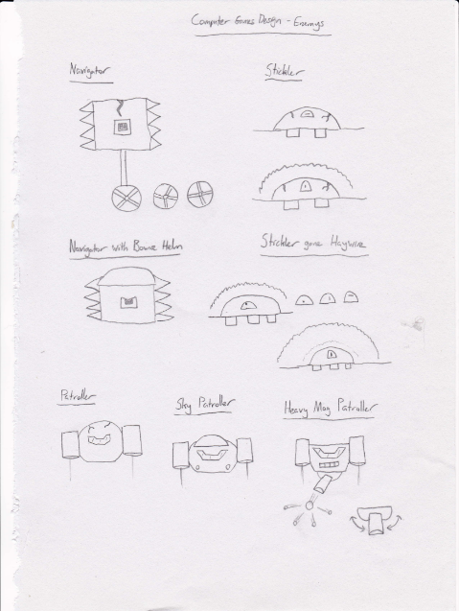
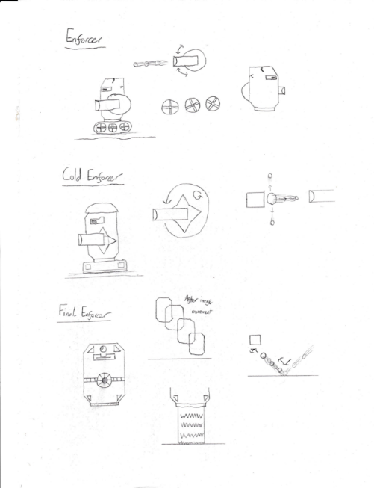
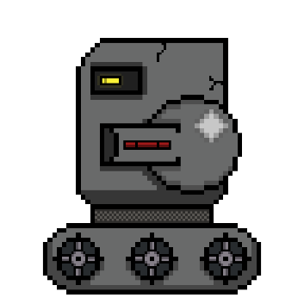



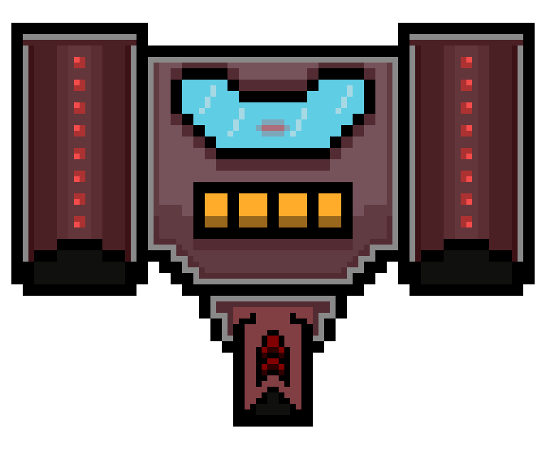
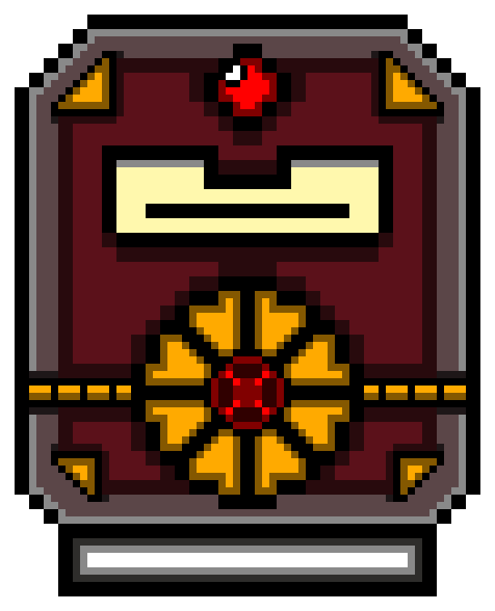
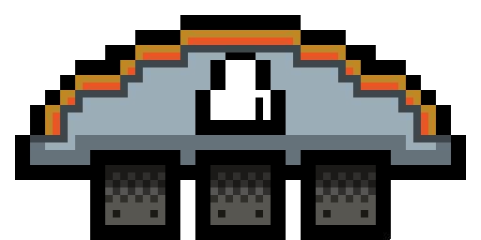
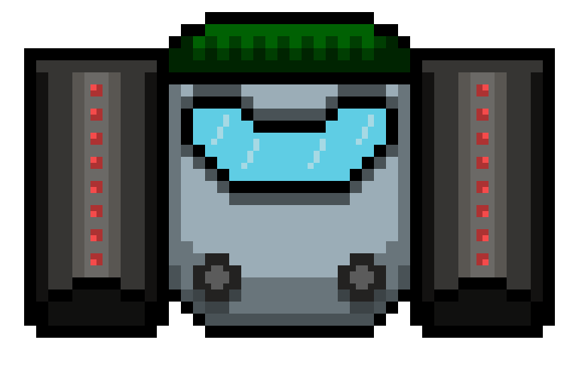

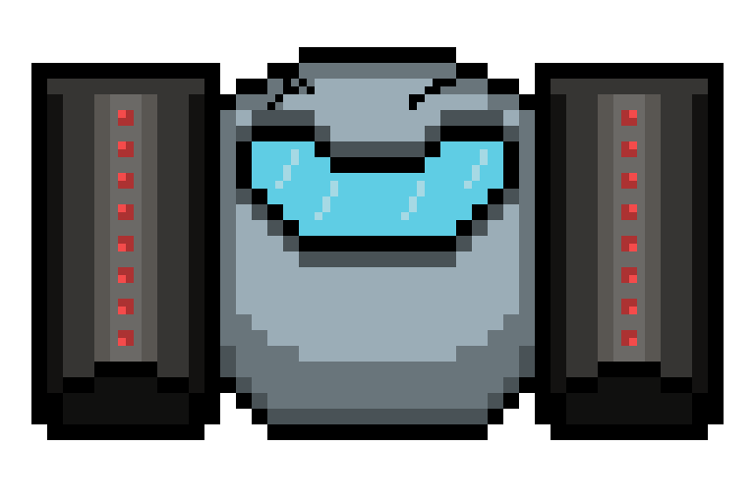
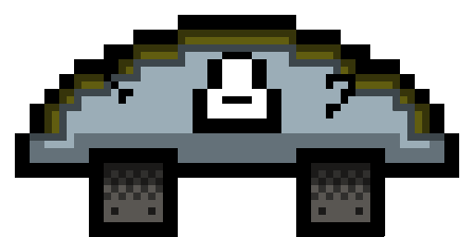
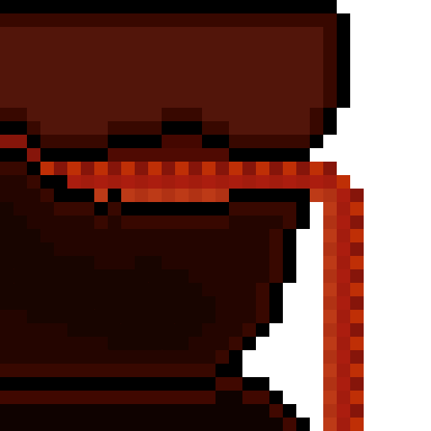
Artwork of the game
The Art Style that we have chosen for our game is Pixel Art, a style that is used in many old retro games and Indie games (Such as Sonic the Hedgehog [Sega, 1991] and Super Meat Boy [Team Meat, 2010]).
We decided on making 2D sprites for our game, because while sprites are easy to shape, a lot of detail and different animations can be produced quickly and efficiently thanks to this style.
The sprites you see before you are created using a program called, “Aseprite”, a purchasable software that you can download from ‘Steam’ that specializes in the creation of Pixel Art and Sprite Editing.
Notes:
[Display images of the various block, enemy and player images]
[Talk about the style of artwork; why we choose to make 2D sprites, how they were made and what they were influenced by]
[Discuss software used – aseprite – visuals of images on the slide]

Slide 10

Project Management and Version Control
Used Discord for communication among group members.
Used Github for version control – unity smaller files – git Ignore
For the most part it worked well for all team members
One instance of losing a few lines of code
Commits are great for updates with detailed specifics below them
Shows exactly side by side what has changed whether removed or added
Would use again for a small project within 1gb/100mb limits
Notes:
[Talk about the use of GitHub and version control – how you found using it and how beneficial was it for file sharing and project communication]

Slide 11
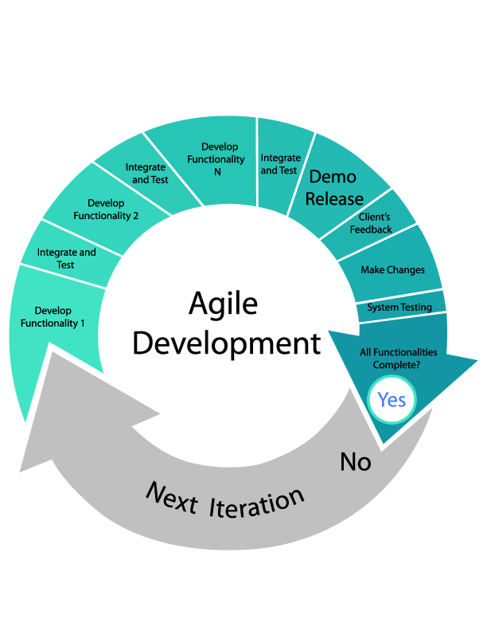
Development Approach for Project
Encourages open communication among team members – small iterations
By breaking down the project into manageable units, the project team can focus on high-quality development and testing
Helps catch defects throughout the development process instead of at the end
E.g. enemy colliders missing – github mess up
Particle system repeating unlimited times
Notes:
[Talk about the Development Model we have gone with (Agile Model); why did we choose that specific model, what were the benefits and mention a practical example of how the Agile approach was useful]

Slide 12
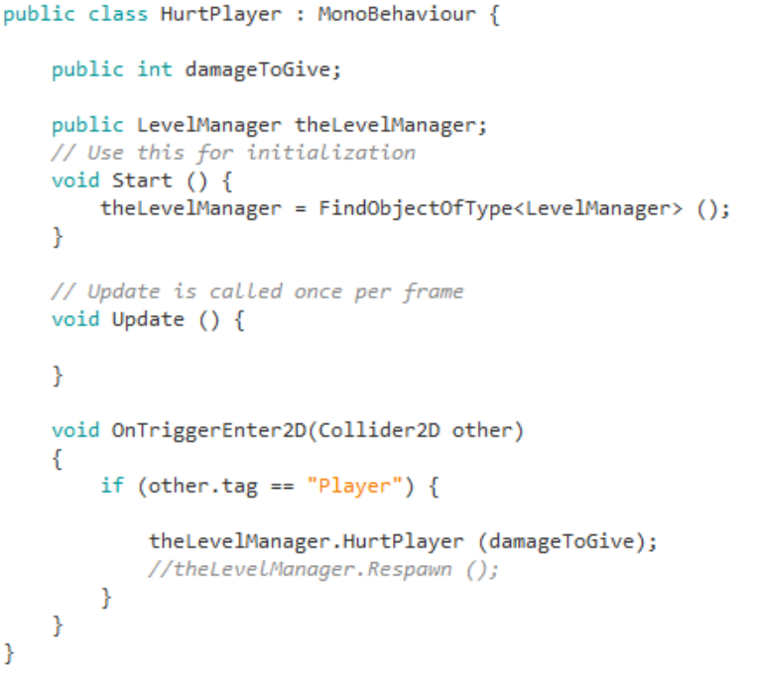
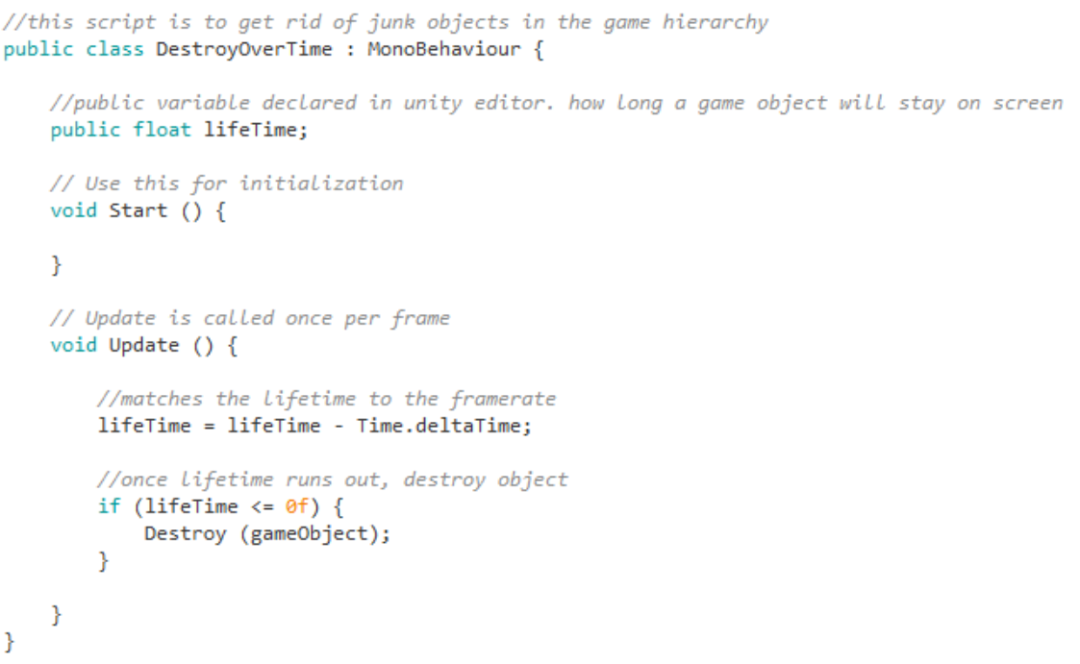
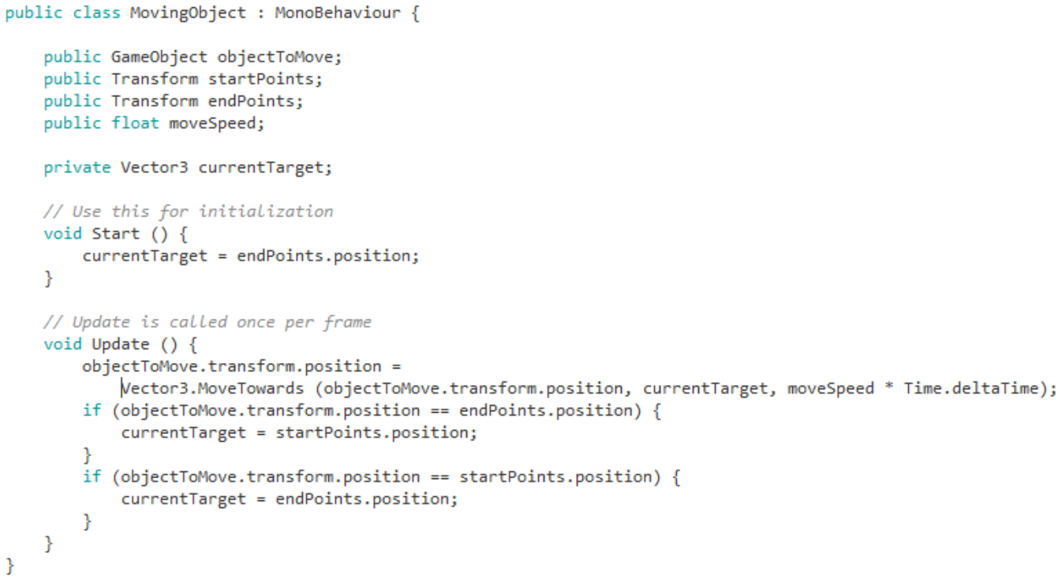

Game Engine and Development Language
We Chose Unity for the game engine – ad support for mobile , smaller project size for repository, asset store, tutorials
C# programming language, quite familiar to myself through college
Notes:
[Talk about the Game Engine we choose to go with (why we choose it over Unreal Engine 4, GameMaker etc. – why Unity was beneficial from a game development perspective)
[What programming language we used for creating the game – C#]
[Show snippets of code used for the game]

Slide 13
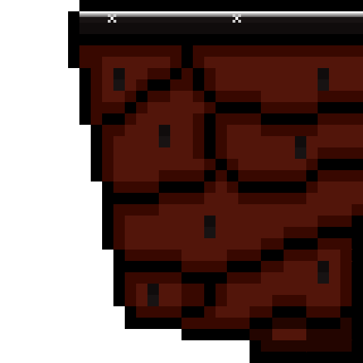
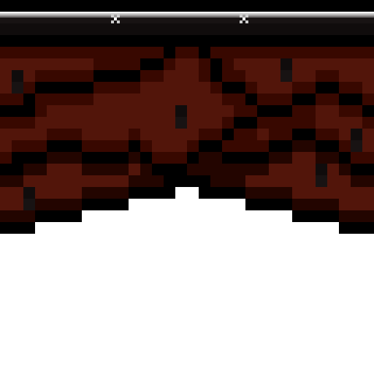
Pedagogical Outcomes
The importance of Communication and Teamwork
Gained experience using different software's and implementing their different uses.
Creating an organization of files and assets to which a group can get access to and upload / replace.
The appeal of Games Design; how to create an enjoyable experience for players.
Notes:
[Talk about what the team has learnt during the course of the project]

Slide 14

Game Demo
https://www.youtube.com/watch?time_continue=313&v=ZxMZBQ9Gzm0
Notes:
[Show a demo of the game in play]

Slide 15
Thank you for listening! Any Questions?
Notes:
[Answer questions]

